Slide 1
DISSOCIATION THEORY,
NEUROPLASTICITY
AND THE HEALING
OF COMBAT STRESS
ROBERT SCAER, M.D. scaermdpc@msn.com www.traumasoma.com

Slide 2

THE ROOTS OF
TRAUMATIZATION:
A THREAT
TO SURVIVAL
IN THE FACE OF
HELPLESSNESS
THE FIGHT/FLIGHT/FREEZE
RESPONSE
Notes:
Need to understand the physiologic substrate of dissociation, & review behavioral neurophysiology of threat and arousal
fight/flight/freeze, freeze discharge Absence of freeze discharge: zoo, lab, domestic, humans

Slide 3

TERROR –
Fear in the face of helplessness

Slide 4
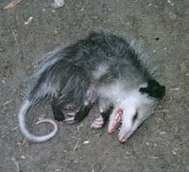
THE FREEZE RESPONSE
Numbing through endorphins
Vagal (parasympathetic) tone
Bimodal sympathetic/
parasympathetic cycling:
(THE ACCELERATOR
/ BRAKE ANALOGY)

Slide 5
HYPNOSIS
- FREUD: “…a paralysis produced by the influence of an omnipotent person on a defenseless, impotent subject”
- PAVLOV: Animal hypnosis - “…a self-protecting reflex of an inhibitory nature”
- Persistence of reflex motor postures imitating the last position of the limbs before hypnosis ensued

Slide 6
LESSONS FROM THE WILD:
THE CRITICAL IMPORTANCE
OF DISCHARGING
THE FREEZE RESPONSE
Notes:
Gamekeeper’s story

Slide 7
FREEZE/IMMOBILIZATION
AND SURVIVAL
BABY CHICKS
NOT
IMMOBILIZED IMMOBILIZED IMMOBILIZED
SPONTANEOUS FORCED
RECOVERY RECOVERY
BEST INTERMEDIATE WORST
DROWNING DROWNING DROWNING
SURVIVAL SURVIVAL SURVIVAL
Notes:
Rats: swim for hours without drowning. Lab rats do better than wild. Wild rats may die during immobilization.

Slide 8
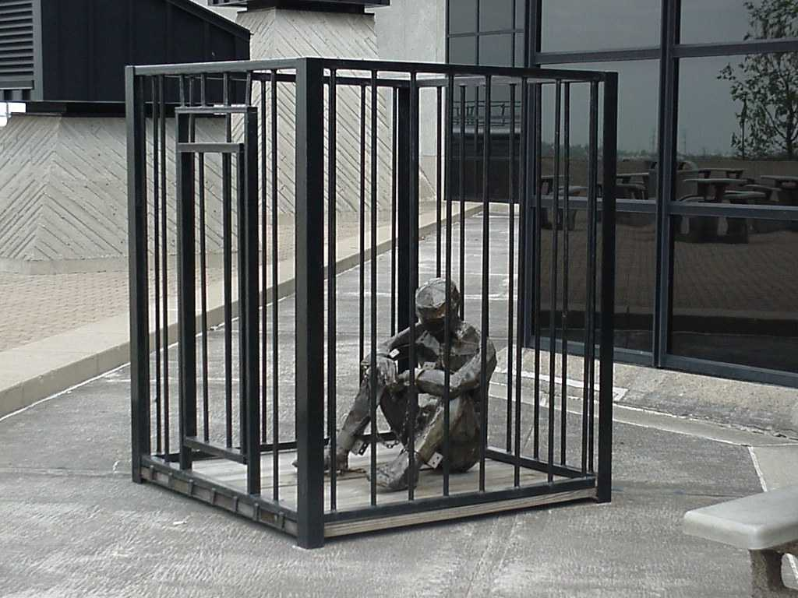
ANIMALS THAT DO NOT DISCHARGE THE FREEZE
Laboratory animals
Domestic animals
Zoo animals
Human animals
Q: WHAT DO THESE ANIMALS HAVE
IN COMMON?
A: THEY ALL LIVE IN A CAGE!

Slide 9
ENDORPHINS IN TRAUMA
Released in arousal: stress-induced analgesia (SIA)
Inhibits ministering to wound, self-care, allows continued fight/flight behavior
Mediates the freeze response
- Analgesia inhibits pain behavior
- Immobility promotes survival

Slide 10
MEMORY MECHANISMS
IN TRAUMA
Declarative (explicit) memory
- Facts and events
Non-declarative (implicit) memory - Emotional associations
- Procedural memory
- Skills and habits
- Conditioned sensorimotor responses
Notes:
Traumatic event/helplessness leads to freeze. Lack of freeze discharge implies lack of completion, events stored in procedural memory, link made between arousal, declarative and procedural
memory through conditioned association.

Slide 11
MEMORY IN TRAUMA
Traumatic Stress: A life threat while in a state of helplessness
This leads to the freeze response
“Discharge” of the freeze response allows “completion” of escape or defense in procedural memory, extinguishes conditioned somatic cues

Slide 12
CONDITIONING IN TRAUMA
Lack of “completion” imprints the conditioned association of:
- The sensorimotor experience (or traumatic cues/triggers) of the body
- The emotional state (terror, rage)
- And the autonomic state of arousal WITHIN PROCEDURAL MEMORY!
This association leads to fear conditioning, or traumatization

Slide 13
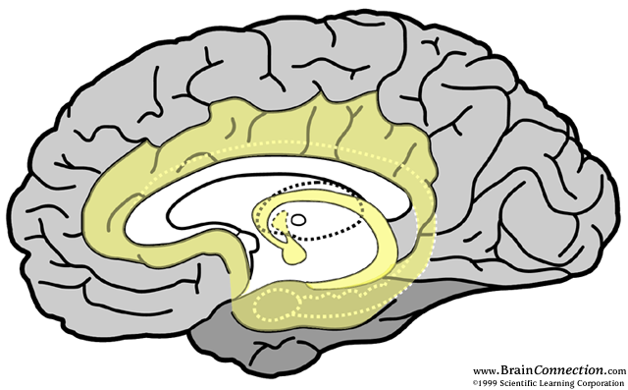
CORPUS CALLOSUM
CINGULATE
GYRUS
THALAMUS
THE
LIMBIC
SYSTEM
FORNIX
HIPPOCAMPUS
ORBITOFRONTAL
CORTEX
AMYGDALA

Slide 14
CEREBRAL CORTEX
HYPOTHALAMUS
HPA AXIS
HORMONAL RESPONSE
ORBITOFRONTAL
CORTEX
ORGANIZES RESPONSE
TO THREAT
INSULA
SOMATIC MARKERS
SENSORY
INPUT
HEAD AND NECK
ANTERIOR
CINGULATE GYRUS
MODULATES
AMYGDALA
THALAMUS
RELAY
CENTER
HIPPOCAMPUS
DECLARATIVE MEMORY
COGNITIVE MEANING
AMYGDALA
AROUSAL
CENTER
LOCUS
CERULEUS
EARLY WARNING
OLFACTION

Slide 15
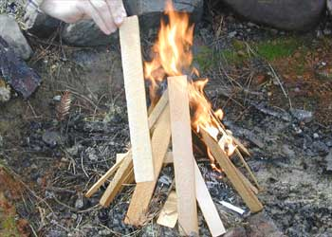
KINDLING
THE DEVELOPMENT OF
SELF-PERPETUATING
NEURAL CIRCUITS
THROUGH REPETITIVE
STIMULATION

Slide 16
The key to trauma:
The retention of traumatic procedural memories through fear-conditioning and kindling

Slide 17
THE DILEMMA OF TRAUMA
The perception that old traumatic procedural memories are actually in the
“present moment”:
A corruption of memory and perception of time
“Then vs. Now”

Slide 18
THE TRAUMA STRUCTURE
Retention of traumatic procedural memories through fear-conditioning
Past memories, triggered by internal/external cues, are perceived as being present
Recurrent unconscious triggering of memories leads to kindling
Repetitive sympathetic autonomic input leads to cyclical autonomic dysregulation

Slide 19
COGNITIVE DEFICITS: P.T.S.D.
Impaired memory in trauma: short term, working, verbal and interference, but not visual memory, proportionate to trauma
Duration of 30 years or more
Attention deficits in traumatized children
Speech and language disorders
Similar deficits in chronic pain, PTSD, depression, fibromyalgia
Findings comparable to cognitive deficits in MTBI

Slide 20
RESILIENCY vs. VULNERABILITY TO TRAUMA
Vulnerability:
A state of fear-conditioned and kindled vulnerability to retraumatization
based on the prior cumulative burden
of life trauma
We must explore what we define as trauma, especially in infancy and childhood

Slide 21
THE ROLE OF
DEVELOPMENTAL
NEUROBIOLOGY
IN RESILIENCE TO
TRAUMA
Notes:
Allen Schore: Affect Development and the Origin of the Self
Maternal/infant dyad facilitates neuronal origin and development of the orbitofrontal cortex, the master regulator of the autonomic n.s. and the brain’s response to threat. Correlates with subsequent resiliency to stress/trauma
Jim Grigsby: Neurodynamics of Personality
Phenotypic (genetic) expression of neural inheritance relatively hard-wired, forms a template on which experience shapes neural networks. Experience creates behavioral attributes/personality/character. Procedural memory involved.
Pathways mediating declarative learning & memory (hippocampus) not myelinated until 12-18 months of life.
Therefore, early resiliency to fear conditioning in trauma may be established through procedural learning in the first 6-12 months of life.
WE need to explore concepts of unrecognized trauma.

Slide 22
THE EXPERIENCE-BASED DEVELOPMENT OF THE BRAIN
Allan Schore, 1996: Affect regulation and the Origin of the Self
* THE Maternal/infant dyad (two-as-one):
Face-to-face attunement facilitates development o the right orbito-frontal cortex, promotes autonomic and limbic regulation and resiliency to subsequent life stress/trauma

Slide 23
PERINATAL STRESS: RATS
Neonatal separation:
Maternal behavior in dam
Steroid response to startle in pup Startle response as adult Hippocampal neurogenesis
- Effects reversed by:
- Increased contact with foster dam
- Postnatal sensory enrichment

Slide 24
MATERNAL CARE:
LICKING/GROOMING (L/G)
L/G behavior occurs on a bell curve of frequency in rat dams
Low L/G behavior in the dam leads to increased CRF gene expression, increased fear behavior and startle, increased CRF and HPA patterns in pups
Low L/G dams exhibit these same behavioral and endocrinological markers

Slide 25
MATERNAL CARE:
LICKING/GROOMING (L/G)
Female pups exhibit the same L/G behavior as their dam, as do their own offspring.
Switching pups from one dam to another defines L/G behavior based on the rearing dam, and in subsequent female generations
Stressing the high L/G dam leads to low L/G behavior in the dam, and in their female pups, and in subsequent female generations

Slide 26
THE EXPERIENCE-BASED
DEVELOPMENT OF
PERSONALITY
Grigsby & Stevens, 2000: The Neurodynamics of Personality
* The phenotypic (genetic) expression of neural inheritance is relatively hard-wired. It forms a template on which experience forms brain neural networks, and therefore personality structure.

Slide 27
PROCEDURAL LEARNING, PERSONALITY AND PSYCHOPATHOLOGY
Pathways mediating declarative memory are not myelinated until 12-18 months, but procedural memory pathways are
Early resiliency to fear conditioning or trauma may be established through procedural learning in the first 6-12 months of live – and probably in utero
The infant’s/fetus’s environment may lay the seeds for subsequent vulnerability to “minor” trauma

Slide 28
PROCEDURAL LEARNING, PERSONALITY
AND PSYCHOPATHOLOGY
Maternal emotional dysfunction may perpetuate patterns of emotional dysfunction in the infant (Genes vs experience in psychiatric disorders)
Genetic disorders (ADHD, dyslexia, autism, bipolar disorder) may actually be predominantly experiential

Slide 29
THE SYMPTOMS OF TRAUMA: DSM-IV
Abnormal arousal
(FIGHT/FLIGHT)
Abnormal avoidance
(FREEZE)
Abnormal reexperienceing, or memory (CONDITIONING)

Slide 30
ADDITIONAL SYMPTOMS
OF TRAUMA
Hypersensitivity to light and sound
Cognitive impairment: ADD, memory loss
Stress intolerance
Loss of sense of self
Shyness, social withdrawal, constriction, depression, dissociation
Chronic fatigue
Somatic symptoms: myofascial pain, fibromyalgia, GI, or bladder symptoms, PMS
Impairment of sleep maintenance
Notes:
i.e.: a variety of somatically-based complaints. What else do we need to know about traumatic stress other than the DSM-IV definitions?

Slide 31
LATE (COMORBID) TRAUMA SYNDROMES
Depression
Dissociation
Affect dysregulation
Somatization
THE CONCEPT OF
COMPLEX TRAUMA

Slide 32

PTSD
IS THE
TIP OF THE
TRAUMA
ICEBERG
PTSD
DESNOS

Slide 33
THE HISTORY
OF TRAUMA
AND DISSOCIATION
IN
PSYCHIATRY
Notes:
33

Slide 34
THE AGE OF HYSTERIA
Breuer, the “talking cure”, and “reminiscences”
Freud, incest and “ The Aetiology of Hysteria”
Freud and Breuer: Recantation
Janet: Perseverance and professional ostracism
Notes:
34

Slide 35
CHARCOT AND THE SALPÊTRIÈRE
THE STUDY
OF HYSTERIA
AS A
NEUROLOGICAL SYNDROME
Notes:
35

Slide 36
JANET AND DISSOCIATION
“Fixed ideas: The spectrum of symptoms in hysteria
Somatic, emotional, perceptual symptoms triggered by trauma
“Absent-mindedness” and abulia – the inability to initiate action
Triggering of hysteria by cues in the environment
Notes:
36

Slide 37
HYPNOSIS
- FREUD: “…a paralysis produced by the influence of an omnipotent person on a defenseless, impotent subject”
- PAVLOV: Animal hypnosis: - “…a self-protecting reflex of an inhibitory nature”
- Persistence of reflex motor postures imitating the last position of the limbs before hypnosis ensued – catalepsy
- Seen in “shell shock” and catatonic schizophrenia

Slide 38
DISORDERS OF
EXTREME STRESS, N.0.S.
(DESNOS)
Alterations in:
- Affect regulation
- Attention/consciousness
- Self-perception
- Relations with others
- Systems of meaning
- Somatizaton

Slide 39
DISORDERS OF
EXTREME STRESS
(DESNOS)
Alterations in affect regulation
- Regulation of emotions
- Modulation of anger
- Self-destructiveness/cutting
- Suicidal preoccupation
- Difficulty modulating sexual involvement
- Excessive risk-taking

Slide 40
DESNOS
Alterations in self-perception
- Ineffectiveness
- Permanent damage
- Guilt and responsibility
- Shame
- Nobody can understand
- Minimizing

Slide 41
DESNOS
Alterations of consciousness
- Amnesia
- Transient dissociative episodes
and depersonalization

Slide 42
DESNOS
Alterations in relations with others
- Inability to trust
- Revictimization
- Victimizing others

Slide 43
DESNOS
Somatization
- Digestive system complaints: IBS, GERDS
- Chronic pain: neck, back, myofascial
- Cardiopulmonary symptoms: palpitations, dizziness, shortness of breath
- Conversion symptoms: weakness, imbalance, RSD
- Sexual symptoms: PMS, pelvic pain, piriformis syndrome

Slide 44
DESNOS
Alterations in systems of meaning
- Despair and hopelessness
- Loss of previously sustaining beliefs

Slide 45
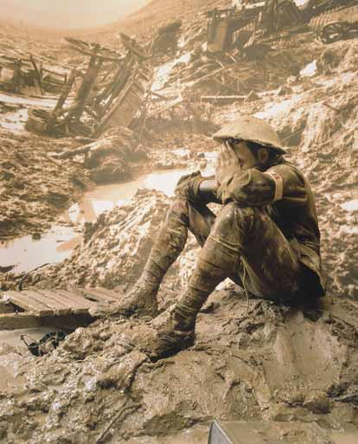
LESSONS FROM WW I
The helplessness of trench warfare and the predominance of dissociative syndromes
(shell shock)
FERENCZI (1919): “..Tic..
An overstrong memory fixation
on the attitude of the body at
the moment of … trauma”.
Hysteria and malingering
Low PTSD/shell shock
incidence in pilots and officers

Slide 46
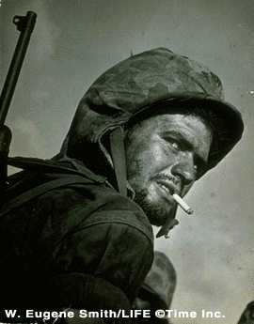
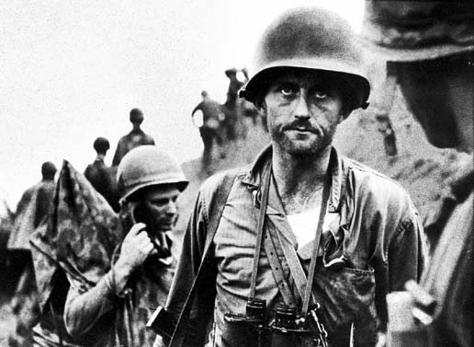
WW II: TRAUMATIC NEUROSIS
Battle fatigue and bonding
Hypnosis, catharsis and
conscious integration
(Kardiner, Grinker and Spiegel)
The post WW-II
abandonment of trauma
as a diagnosis

Slide 47
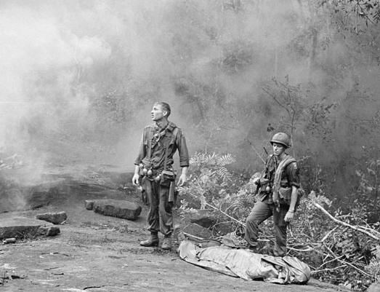
VIETNAM AND P.T.S.D.
The role of societal rejection
Bonding through “rap groups”
1980, THE A.P.A. and P.T.S.D.
The women’s movement and
gender-based trauma

Slide 48


TRAUMA IN COMBAT
Exposure to danger in combat
Seeing a buddy wounded or killed
Sense of guilt in not
saving buddy
Exposure to horrific
wounds/body parts

Slide 49
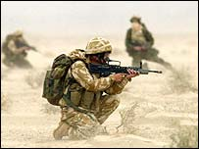
TRAUMA IN COMBAT
Killing or seeing civilian non-combatants killed
Being wounded in combat
Exposure to shame
by superiors
Exposure to
I.E.D./Blast concussion

Slide 50

DESNOS in COS
Loss of joy
Despair and grief
Survivor guilt
Yearning for combat

Slide 51
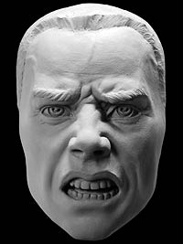
DESNOS in COS
Anger, irritability
Mood swings
Feelings of isolation
Withdrawal

Slide 52

DESNOS IN COS
Numerous somatic symptoms
Reckless behavior /
risk-taking
Aggression / self harm
Substance abuse

Slide 53

DESNOS IN COS
Difficulty with relationships
Poor work performance
Unexplained absences
Loss of spirituality

Slide 54

MTBI IN COS
Post-concussion syndrome:
? Somatosensory procedural
memory for experiences
of the traumatic event
Cognitive impairment
due to dissociation in
trauma
NEJM: Increased incidence
of PTSD in victims
of “concussion”
due to I.E.D.’s

Slide 55

PHYSICAL SYMPTOMS
IN COS
Bowel symptoms:
- Cramps and diarrhea
- Nausea and indigestion (GERDS)
Shortness of breath
Palpitations, chest pain

Slide 56
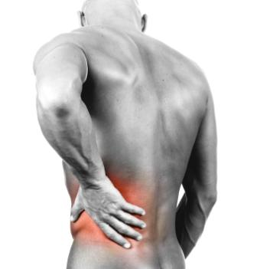
PHYSICAL SYMPTOMS
IN COS
Migraines and tension headaches
Neck and back pain
Chronic fatigue
Restless legs / cramps

Slide 57
THE DILEMMA OF KILLING
The history of killing rates in 19th century warfare: 1-2 shots/minute vs. 50% in practice
The impact rate in firing squads
Gen. Marshall –WWII: 15-20% firing rate
BUT – firing rates in Korea: 55%, in Vietnam: 90- 95%
The effectiveness of operant/classical conditioning
The residual legacy of guilt/shame

Slide 58
DISSOCIATION:
The primary expression of DESNOS and Combat Stress

Slide 59
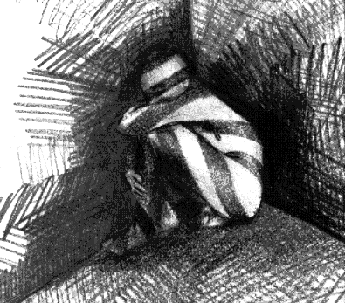
Dissociation:
The perceptual component of the freeze response?

Slide 60
MANIFESTATIONS
OF DISSOCIATION
Derealization
Depersonalization
Distorted time perception
Distorted sensory perception
Amnesia
Fugue states
Conversion reaction/hysteria
Dissociative identity disorder

Slide 61
DISSOCIATION PSYCHOBIOLOGY
SCHORE (2005):…”vagal outflow from the dorsal vagal nucleus …is the psychobiological engine of …dissociation”
…”early trauma expressed as emotional neglect and abuse…predict…dissociation.”
i.e.: Impaired attachment and right O.F.C. development leads to autonomic dysregulation, and the emergence of dorsal vagus freeze/dissociative states.

Slide 62
THE DORSAL VAGUS NERVE
The dorsal vagal complex (DVC)
- The dorsal vagal nucleus
- Primitive, reptilian
- Low O2 utilization
- The dive reflex: apnea, bradycardia
- The freeze response, the risk in mammals
and “voodoo death”

Slide 63
BUT! The dorsal vagal/freeze theory does not explain the occurrence of high sympathetic-dominant dissociative states:
Homicidal dissociation
“Berserker” behavior in combat

Slide 64
DISSOCIATION STRUCTURE
A capsule, compartment or state of perception composed of the varied procedural memories of the experiences of a past traumatic event where a freeze response occurred without a freeze discharge

Slide 65
THE DISSOCIATION CAPSULE IS COMPOSED OF:
Somatosensory messages and motor actions
Autonomic states
Emotions
Endorphinergic alteration of perception
Emotion linked declarative memory ALL SPECIFIC TO
THE TRAUMATIC EXPERIENCE

Slide 66
FEATURES OF THE DISSOCIATIVE CAPSULE
Capsules consist of procedural memories for the past trauma, but are perceived as being present, and are therefore dissociative

Slide 67
EXAMPLES OF CAPSULE PROCEDRAL MEMORIES
Pain, numbness, dizziness
Tremor, tics, paralysis
Nausea, cramps, palpitations
Anxiety, terror, shame, rage
Flashbacks, nightmares or intrusive thoughts

Slide 68
The Dissociative Capsule is brought into conscious awareness (the present moment) by external representative cues or internal kindled memories

Slide 69
The size, specificity and strength of a Dissociative Capsule depend upon the intensity or repetitive experience of the trauma that caused it

Slide 70
The number of one’s Dissociative capsules is determined by the sum total of one’s cumulative life traumas

Slide 71
The more the number of Dissociative Capsules, the less time one is able to spend in consciousness (the present moment)

Slide 72
THE PRESENT MOMENT
1-10 second period of the awareness of “now”
A “lived story”
Background feelings from the body
Autobiographical memory
Changing internal and external perceptions
Concepts of time, intentionality, shifting emotional tone
A measure of consciousness
Our changing sense of self

Slide 73
THE SELF
Antonio Domasio –
“The embodied mind”:
Somatic sensations (feelings) of the present moment superimposed on our autobiographical memory and our anticipated future

Slide 74
PROCEDURAL
MEMORY CUES
SOMATOSENSORY
LIMBIC/EMOTIONAL
-AUTONOMIC
- EMOTION-LINKED DECLARATIVE MEMORY
PROCEDURAL
MEMORY CUES
- SOMATOSENSORY
- LIMBIC/EMOTIONAL
- AU TONOMIC
- EMOTION-LINKED
DECLARATIVE MEMORY
THE STRUCTURE AND RELATIONSHIPS OF DISSOCIATIVE CAPSULES
AUTONOMIC CUES
SOMATOSENSORY CUES
INJURY
MVA
LIMBIC CUES
PROCEDURAL
MEMORY CUES
AUTONOMIC
LIMBIC/EMOTIONAL
EMOTIONA-LINKED
DECLARATIVE MEMORY
THE PRESENT MOMENT
PROCEDURAL MEMORY
CUES
- SOMATOSENSORY
LIMBIC/EMOTIONAL
AUTONOMIC
- EMOTION-LINKED
DECLARATIVE MEMORY
GRIEF
PROCEDURAL MEMORY
CUES
- AUTONOMIC
- LIMBIC/EMOTIONAL
- EMOTION - LINKED
DECLARATIVE MEMORY
INCEST
SHAME

Slide 75
What implications does the Dissociative Capsule have for healing trauma?
To heal trauma we must extinguish posttraumatic procedural memory cues.

Slide 76
AND YOU CAN’T DO
THAT WITH WORDS
ALONE!

Slide 77
THE CONCEPT OF BRAIN PLASTICITY HAS UNIQUE APPLICATION TO THE STUDY OF TRAUMA

Slide 78
BRAIN NEUROPLASTCITY
1965: Hippocampal neurogenesis from stem cells
1980’s: rat brain weight increased with labyrinth exercise, blocked by stress
1990’s: Hippocampus, possible frontal cortex neurogenesis, decreased in stress/depression d/t cortisol but improved with treatment
2000’s: influence of “rewiring” – increased circuits, brain size: Einstein’s brain, Cab driver’s brains. Rewiring may play primary role

Slide 79
BRAIN PLASTICITY:
REMAPPING
The concept of brain maps: compensatory remapping of cortex to assume lost function
- Activation of occipital (visual) cortex in blind subjects reading Braille
- Cutting nerve, amputating parts of body: adjacent cortex assumes function
- Remapping in cochlear implants
- Webbed finger anomaly: remapping with separation
- Brain maps enlarge with practice, then shrink with refinement/precision

Slide 80
LEARNED NON-USE
Diminished limb function with prolonged immobilization or paralysis: the “dissociated limb”
Taub: paralyzed limb in stroke or
deafferentation improved with immobilization of opposite limb
Ramachandran: use of mirror box in RSD, phantom limb pain

Slide 81
NEUROPLASTICITY IN TRAUMA:
THE PLASTICITY PARADOX
Kindling may cause harmful remapping through incorporation of similar trauma cues: long term potentiation
Impaired hippocampal neurogenesis in childhood trauma: attention and memory deficits
Impaired neuronal development of orbitofrontal cortex in impaired infant attunement
Somatic dissociation and conversion hysteria

Slide 82
NATURE VIA NURTURE
The role of the epigenome
Obesity in the grandfather predicts shortened life span in the grandson.
Poor maternal diet predicts increased heart disease in the child.
? A cause for apparent “epidemics” of genetic diseases.

Slide 83
NEUROPLASTICITY
IN ADDICTION
Most addictive drugs trigger release of dopamine by the ventral tegmentum, activating the pleasure center, the nucleus accumbans (opiates, cocaine, amphetamines, nicotine, alcohol). Cannabis probably mimics and replaces endogenous cannabinoids. Benzodiazepines and alcohol also affect GABA neurotransmitter systems.
Giving a hormone/neurotransmitter exogenously “shuts down” production by the body/brain, creates need for more exogenous input and addiction because of neurotransmitter receptor site sensitization.

Slide 84
CHILDHOOD TRAUMA AND DISEASE IN ADULT LIFE
Felitti, AJPM, 1998: THE ACE STUDY
Graded correlation between severity of childhood trauma (adverse life experiences), and the leading causes of death:
- Heart disease, stroke, cancer, COPD, fractures, liver disease
- Obesity, alcoholism and other addictions, suicide, depression
- Dramatic reduction in longevity

Slide 85
NEUROPLASTICITY AND HEALING TRAUMA
Therapy rewires the brain and takes time
Regulatory skills restore homeostasis, reduce serum cortisol, restore the hippocampus
Mindfulness and attunement skills inhibit the amygdala, enlarge frontal cortex
Fear extinction of traumatic memory cues inhibits kindling
Empowerment replaces helplessness
Increased frontal cortex, hippocampus in meditation

Slide 86
THE KEY INGREDIENT IN HEALING TRAUMA
Extinguishing
the Dissociative Capsule by
down-regulating the amygdala during imaginal exposure
to its contents.

Slide 87
TRAUMA THERAPY:
THEORETICAL CONSIDERATIONS
Extinction of conditioned cues: accessing memory while inhibiting the amygdala
- The power of ritual
- Integrating the cerebral hemispheres
- Empowerment through affirmation
Reconsolidation of memory
“Completion” of defense/escape: the freeze discharge
Restoring homeostasis
Transformation and wisdom through meaning

Slide 88
THE DILEMMA OF
PHARMACOTHERAPY
Treating a bipolar syndrome
Reciprocal side effects
Side effects become traumatic cues or triggers, perpetuate kindling
Narcotics in chronic pain

Slide 89
TRAUMA THERAPY
Psychotherapy
- Cognitive/behavioral therapy: most thoroughly evaluated
- Exposure therapies:
- Imaginal exposure
- In-vivo exposure
- Systematic desensitization
- Best for arousal and anxiety
- Less effective for avoidance and dissociation
- ? Long-term efficacy

Slide 90
TRAUMA THERAPY
Reconnecting with the body
- Somatic dissociation and the felt sense
- The use of movement therapy: Yoga, dance, balance, equestrian therapy
- The use of therapeutic body work and exercise
- The use of artistic media
- Biofeedback

Slide 91
GUIDED IMAGERY
Used in almost all techniques
Deriving the SUD’s scale
Accessing the memory to be extinguished
Manipulating the memory through imaginal reversal
Facilitating the felt sense

Slide 92
SOMATIC EXPERIENCING
Accessing the felt sense
Tracking through “pendulation”
Elicitation of
somatic/sensorimotor/autonomic responses: the freeze discharge
Concepts of completion/uncoupling/extinction

Slide 93
ENERGY PSYCHOLOGY
Thought field therapy(T.F.T.), Emotional Freedom Technique (E.F.T.), Healing Touch
* Use of SUD’S scale
* Affirmative statements, meridian tapping, humming, vocalization, eye movements and imaging
* Mode of action: Empowerment, integrating the hemispheres, ritual, extinction, homeostasis

Slide 94
EMDR
Use of the SUD’S scale
Alternating eye movements, auditory or tactile stimuli linked to imagery of the trauma
Positive and negative cognitions
The REM connection:
- Processing arousal memory
- Memory consolidation
- Cerebellar-cingulate connection
Affirmation, ritual

Slide 95
BRAINSPOTTING
Slowly passing a pointer around the peripheral field of the patient
Close observation for subtle motor responses
Intense focus on the “brain spot”
Elicitation of memory, emotional response
Relationship to boundary concepts
Relationship to eye position
Role of intense attunement in therapeutic effect

Slide 96
NEUROFEEDBACK
Driving the brain into the present moment
Comparison to deep mindful meditation
Applicable conditions:
- ADD/ADHD, OCD
- Addictions
- Criminal behavior
- Fibromyalgia/CFS
- Mood disorders, PTSD, anxiety
- Somatization
- MTBI

Slide 97
The role of cognitive meaning and the acquisition of wisdom

Slide 98
TRANSFORMATION AND
WISDOM
1. The recognition and management of uncertainties
2. The integration of affect and cognition
3. The recognition and acceptance of human limitations, including the finitude of life
i.e.: LIFE IN THE PRESENT MOMENT

